Slide 1
Super-know-you Mall
Group member:
史云霞 1801212920
谌子民 1801212832
陈博闻 1801212827
叶珏琳 1801212963
罗雪 1801212899
Date:
2020-01-13

Slide 2

01
Pain points & Our solution
02
Training data description & Algorithm introduction
03
CONTENTS
Data Structure
04
Data Analysis
05
Big Data Application: Super-know-you Mall

Slide 3
Motivation
& Our solution
01
PART

Slide 4






Imagine a scenario…
❌
Tedious/ undesired/
outdated category
Hard to find target stores
Expensive price
Miss the promotion
Leave the mall/
Consume online
Went into a mall
400
20%
Average vacancy rate
In next
3-5
years
Shopping malls
600
Brands
35%
Vacancy rate
Notes:
中国社科院和社会科学文献出版社23日共同发布的《房地产蓝皮书(2019)》指出，2019年商业地产市场的不确定性增强、市场竞争加剧、商业创新加速、存量更新加速、资产证券化加速。从空置来看，预计未来3-5年商业项目平均空置率将达到20%以上，商业整合并购的趋势加速。

Slide 5
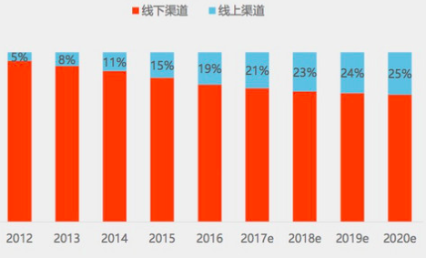
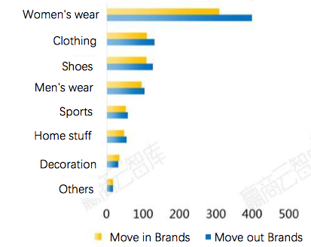
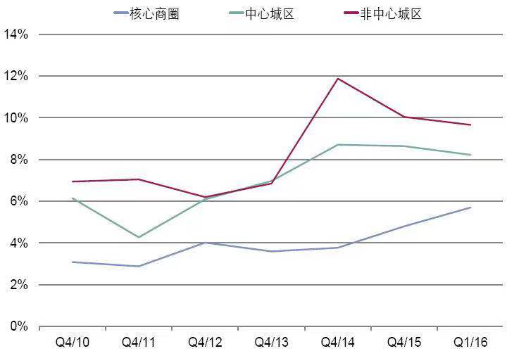








Pain points of offline malls
Customers
Stores
Shopping centers
2012-2020e Online and Offline sales portion
2018 Brand change of core business district in 1st tier cities
Vacancy rate of Shanghai Malls
Core
Business
District
Online
Offline
Center
District
Non-Center
District
FACTS
Customers consume less offline
Low sales & high costs causing stores’ moving out
High vacancy level
Inefficient site selection
Unreasonable SKU selection
Failed to recognize customers’ needs
Poor interaction of discount activities
Unreasonable store layout
Low sales conversion of customer flow
Failed to activate member repurchase
Poor customer stickiness & interaction
LACK OF OFFLINE
CUSTOMER DATA!
CAUSES

Slide 6
Our Big Data Solution
Offline Data
Algorithm/ Model
Visualization
Analysis Platform
Face Detection
Shopping mall
Camera
Single moving trail
Floor diversion
Algorithm 1
Customer
Faces
Group moving trail
Regional analysis
Face Alignment
Data
Cleaning
Algorithm 2
Data
Consolidation
Commercialization
Stores
Time stamp
Heat map
Face Recognition
Customer flow analysis
Location
Algorithm 3
Customer portrait
Site selection
SKU selection
Enhance operation & marketing efficiency and profitability

Slide 7
Training data description
& Algorithm introduction
02
PART

Slide 8
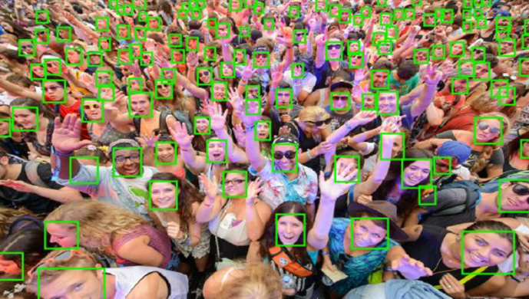
Face Identification
Face Detection: Find all the face positions in the image, usually marked with a rectangular box. The input is an image, and the output is several box positions containing faces.
Face Alignment: Find the eyes, Corners of the mouth, nose on a face
Face Identification: Match the face with the identity.

Slide 9
Data description
Annotated face dataset from Chinese Academy of Sciences: 70% for training, 30% for testing
 | Features
Number | 2,2404 images, 7,1711 labeled faces
Multi-face | An average of 3.2 faces/images.
Skin Color | Yellow, white
Specification | Rectangular and elliptical box
Appearance | Rich facial expressions and poses, multi-angle (frontal or side faces)
Gender | 59% are tagged as female, 41% are tagged as male
Age | 5 years old ~ 79 years old
Background | Indoors and outdoors
Image Color | 81% color images and 19% grayscale images
Resolution | 100 x 100 pixels ~ 4480 x 2560 pixels

Slide 10
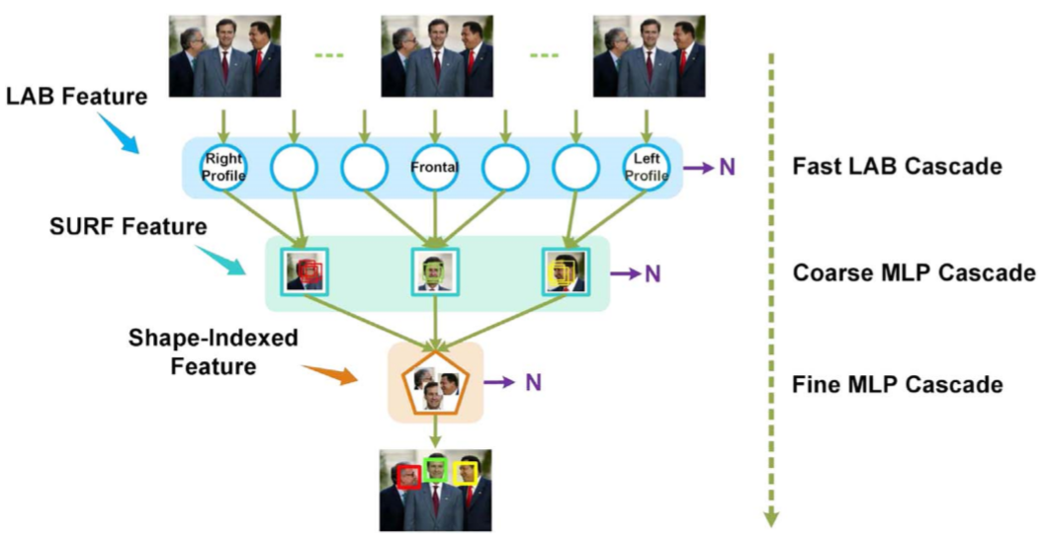
Face Detection
Face Detection Method Introduction
Multiple view-speciﬁc fast LAB cascade for extremely quick face proposal
Multiple coarse MLP cascade for further candidate window veriﬁcation
A uniﬁed ﬁne MLP cascade with shape-indexed features for accurate face detection
Notes:
Multi-view face detection in open environment is a challenging task due to diverse variations of face appearances and shapes. Most multi-view face detectors depend on multiple models and organize them in parallel, pyramid or tree structure, which compromise between the accuracy and time-cost. Aiming at a more favorable multi-view face detector, we propose a novel funnel-structured cascade (FuSt) detection framework.
In a coarse-to-fine flavor, our FuSt consists of, from top to bottom：
(1) Multiple view-specfic fast LAB cascade for extremely quick face proposal. Although the LAB feature is quite computationally eﬃcient, it is less expressive and has diﬃculty modeling the complicated variations of multi-view faces for a high recall of face windows. Therefore, we adopt a divide-and-conquer strategy by dividing the diﬃcult multi-view face detection problem into multiple easier single-view face detection problems. Specifically, multiple LAB cascade classifiers, one for each view, are leveraged in parallel and the final candidate face windows are the union of surviving windows from all of them.
(2) Multiple coarse MLP cascade for further candidate window verification. SURF features are more expressive than LAB features, but are still computationally efficient benefited from the integral image trick. Therefore face windows can be better differentiated from non-face windows with low time cost. Furthermore, MLP is used with SURF feature for window classification, which can better model the nonlinear variations of multi-view faces and diverse non-face patterns with the equipped nonlinear activation functions.
(3) A unified fine MLP cascade with shape-indexed features for accurate face detection.

Slide 11
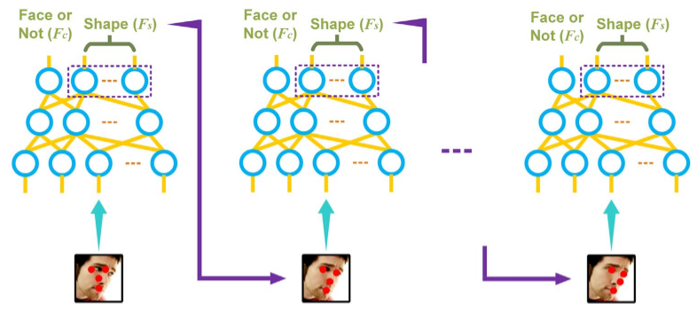
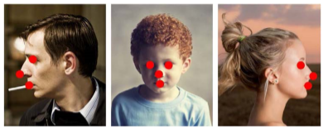
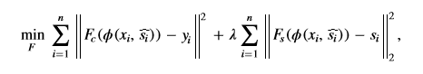
Face Detection
Unified Fine MLP Cascade
We adopt shape-indexed features extracted at semantically consistent positions as the input of the Fine MLP Cascade classiﬁer. As shown in Fig, four semantic positions are selected, corresponding to the facial landmarks of left and right eye center, nose tip and mouth center.
In multiple cascaded MLPs, the shapes used for feature extraction become more and more accurate stage by stage, leading to more and more distinctive shape-indexed features and further making multi-view faces more distinguishable from non-face regions. A uniﬁed ﬁne MLP cascade with shape-indexed features for accurate face detection

Slide 12
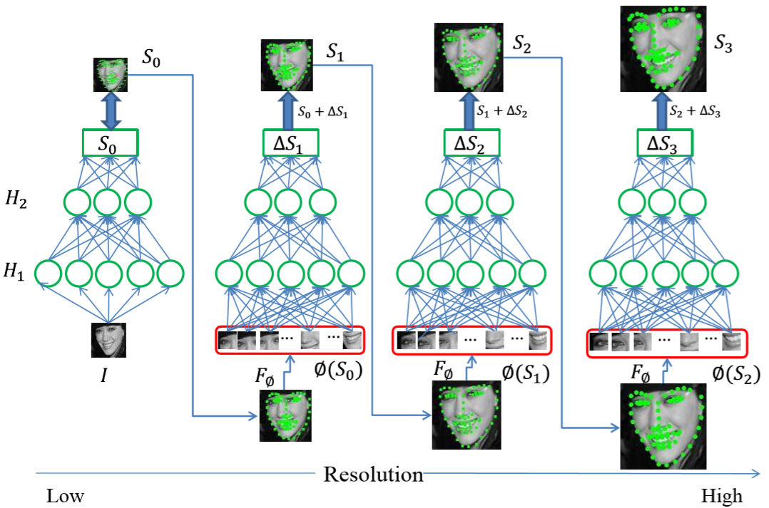
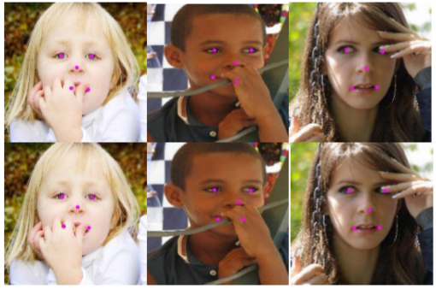
Face Alignment
Face Alignment Method Introduction
We propose a Coarse-to-Fine Auto-encoder Networks (CFAN) approach, which cascades a few successive Stacked Auto-encoder Networks (SANs). Speciﬁcally, the ﬁrst SAN predicts the landmarks quickly but accurately enough as a preliminary, by taking as input a low-resolution version of the detected face holistically. The following SANs then progressively reﬁne the landmark by taking as input the local features extracted around the current landmarks (output of the previous SAN) with higher and higher resolution.

Slide 13
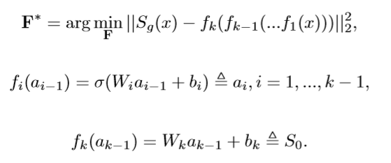
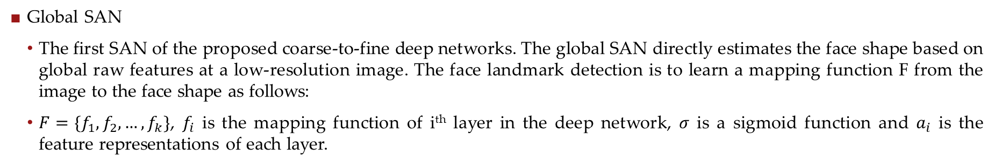
Face Alignment
Global SAN
The first SAN of the proposed coarse-to-fine deep networks. The global SAN directly estimates the face shape based on global raw features at a low-resolution image. The face landmark detection is to learn a mapping function F from the image to the face shape as follows:
$F=\{f_{1}, f_{2},…,f_{k}\}$, $f_{i}$ is the mapping function of i^{th} layer in the deep network, $σ$ is a sigmoid function and $a_{i}$ is the feature representations of each layer.

Slide 14
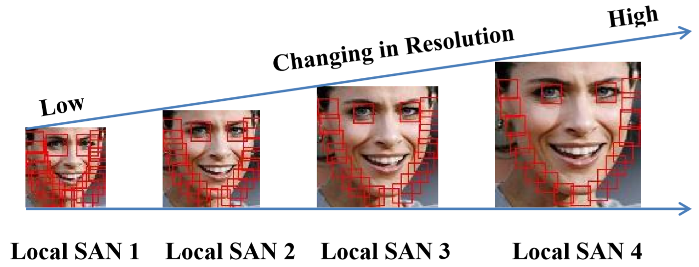
Face Alignment
Local SANs
Similarly as the global SAN, the successive local SAN is also designed as a stacked deep auto-network to deal with the nonlinearity of predicting the face shape, but with the local shape-indexed feature as input.
It is necessary for the anterior SANs to approximate with a large search step when the current location is relatively far from the ground truth. On the other hand, the local patches of the same size but at high resolution face images actually constrain the searching within a small region which means that the posterior SAN can refine the location with a tiny step leading to more accurate results.

Slide 15
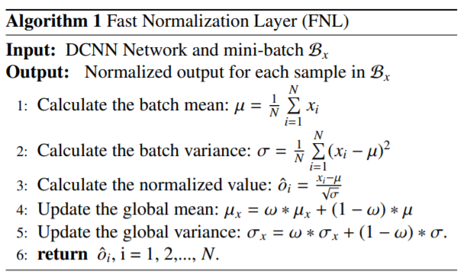
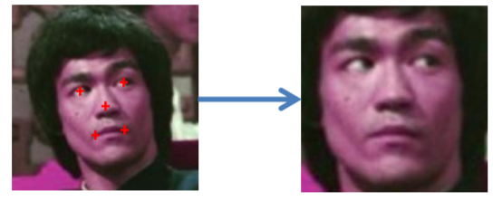
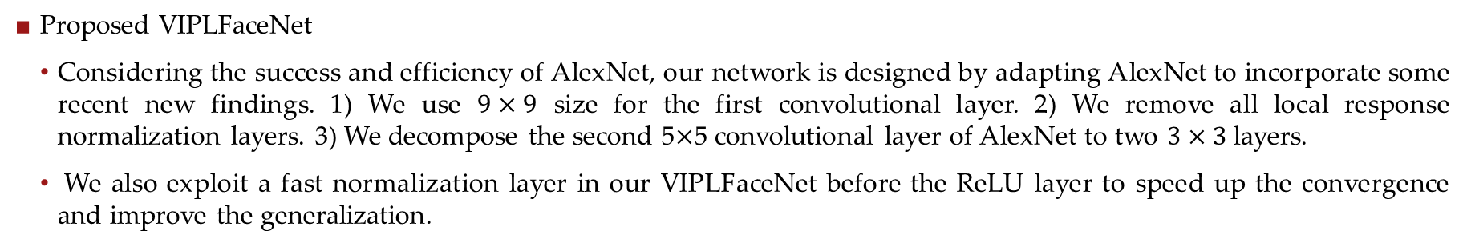
Face Identification
Proposed VIPLFaceNet
Considering the success and efficiency of AlexNet, our network is designed by adapting AlexNet to incorporate some recent new findings. 1) We use $9×9$ size for the first convolutional layer. 2) We remove all local response normalization layers. 3) We decompose the second 5$×$5 convolutional layer of AlexNet to two $3×3$ layers.
We also exploit a fast normalization layer in our VIPLFaceNet before the ReLU layer to speed up the convergence and improve the generalization.

Slide 16
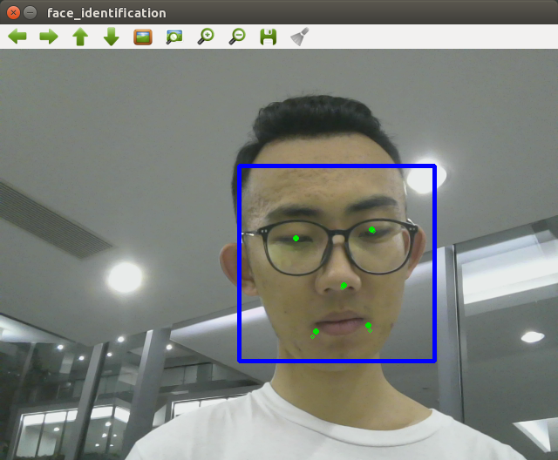
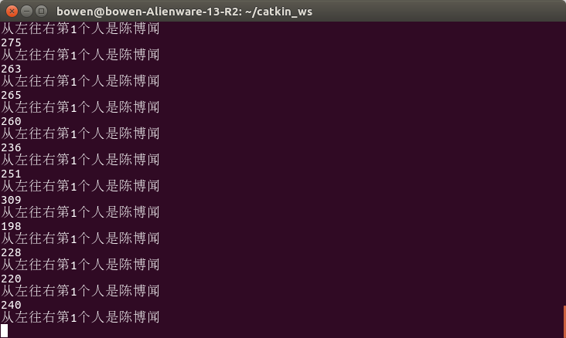
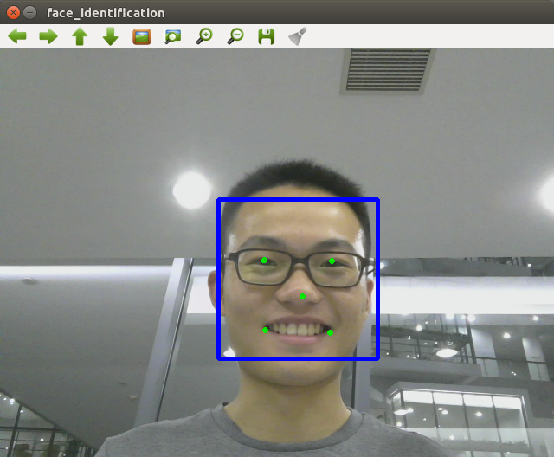
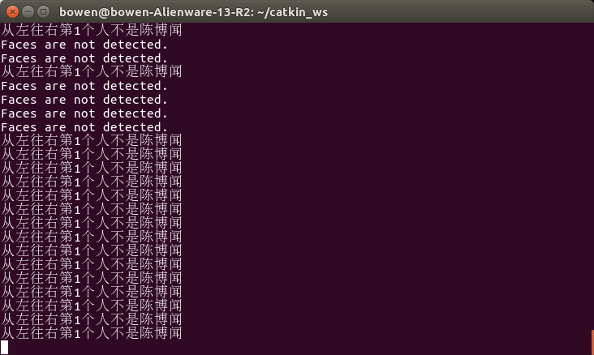
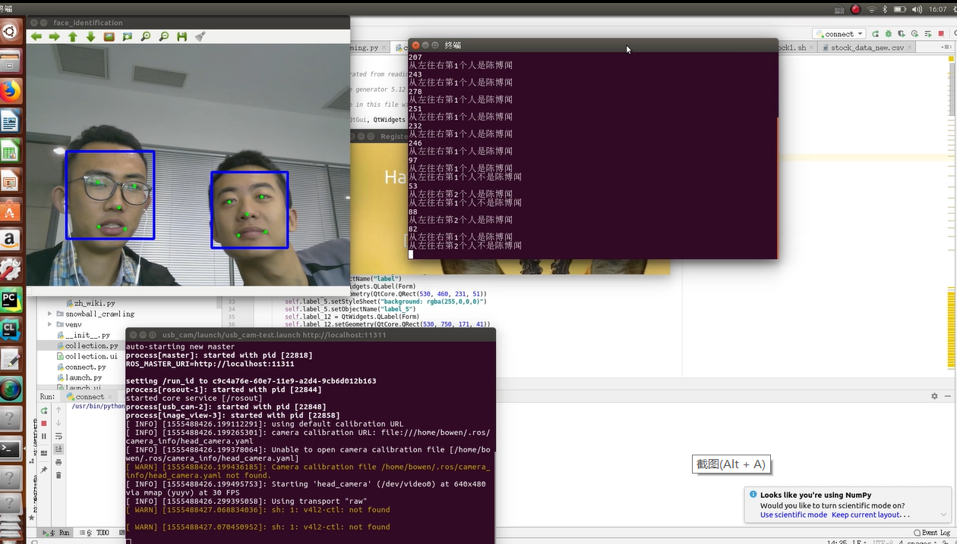
Results
Network Architecture | Crop Size | Accuracy
VIPLFaceNet | 256 | 98.12%
VIPLFaceNet | 248 | 98.53%
VIPLFaceNet | 227 | 98.60%
VIPLFaceNet | 200 | 98.57%
VIPLFaceNet | 180 | 98.21%

Slide 17
Data Structure
03
PART

Slide 18
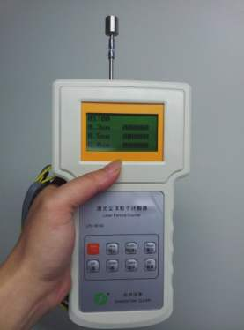
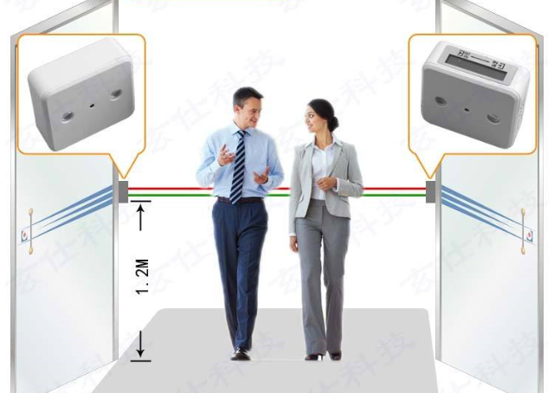
Traditional Customer Flow Counting Methods
The traditional passenger flow statistics methods including manual and infrared counting. These two schemes are relatively time consuming with low accuracy, and can only get the number of passengers.
Notes:
What’s more important they can’t identify the customer’s identity, which makes the offline customer flow data limited.
To solve this problem, we put forward our face identification scheme.

Slide 19
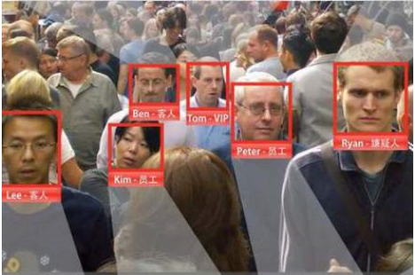
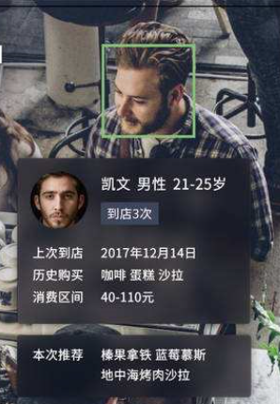
Customer Flow Data with Face Identification
Kevin male
22years old
Layout a offline camera network in the mall
Use face identification technology to identify consumers
Personal behavior data & Customer portrait
Data marketing and refined operations.
Last come 2019.12.14
Historical purchase coffee cake
Consumption interval ￥40-110
Recommend blueberry mousse
hazelnut latte
Notes:
We can layout a camera network in the mall to collect images of consumers' path.
Use face identification technology to identify those consumers.
In this way, we can get personal behavior data.
With face identification, we can get the rich offline data to conduct data marketing and refined operations.

Slide 20
Customer Flow Data we collect
Personal information table:
Personal information of users from store membership database
Customer flow data table:
The output user behavior data from face identification algorithm
uid | name | sex | age | register time | membership level
0000001 | Alex | female | 26 | 20180108 | 2
0000002 | Bob | male | 32 | 20180608 | 1
0000003 | Carl | female | 40 | 20150405 | 3
0000004 | David | male | 23 | 20170202 | 1
0000005 | Eson | male | 45 | 20170507 | 1
0000006 | Far | male | 33 | 20190409 | 1
0000007 | Grace | female | 37 | 20121212 | 3
0000008 | Helen | male | 61 | 20090304 | 5
0000009 | Jenny | female | 33 | 20180303 | 3
0000010 | Karl | male | 25 | 20191220 | 1
0000011 | Lam | male | 28 | 20140708 | 4
0000012 | Mom | female | 31 | 20180209 | 2
time | location | user id
2019-12-31 9:00:01 | A | 0000001
2019-12-31 9:00:01 | A | 0000010
2019-12-31 9:00:01 | B | 0000006
2019-12-31 9:00:02 | B | 0000001
New customer
Notes:
Since we have no right to layout the camera network in the mall and we don’t have the customer flow pictures.
To do the later big data analysis, we suppose we can get the personal information data from store membership database and consumer flow data from our face identification algorithm.
Personal information table includes user id, name, sex, age, register time and membership level.
Through it, we can get more features of the customer
Consumer flow data:
Time information: each camera will take a picture every second. The shooting time is recorded as a timestamp.
Location information: each camera has a unique location number, which is bound to the camera and will be recorded for each shot.
User name: use face identification algorithm to identify the user at current location; also record the new customer.

Slide 21
Data Analysis
04
PART

Slide 22
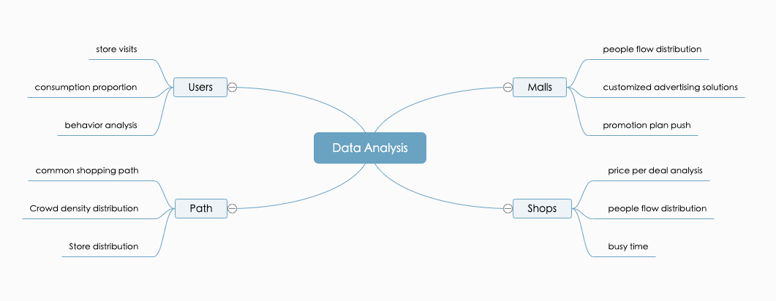
Data Analysis
The face recognition algorithm can transform offline shopping behavior into structured data that can be calculated by the algorithm. This data has great practical application value for shopping malls, stores, and individuals.
We have multiple ways of processing：We can aggregate data according to time and working days to guide the marketing strategy of the mall according to the user's browsing distribution habits; we can also analyze individual users, portray customer portraits, and conduct refined operations.
Data analysis aspects：

Slide 23
Malls aspects
The line chart represents customer traffic and the bar chart represents the total number of orders.
Operating hours
Dynamically adjust business hours based on the flow of people in the mall to improve work efficiency.
Customized advertising price
According to the distribution of customer traffic, differentiated pricing for advertisements in different time periods.
Promotional plans
From 3 pm to 5 pm, the orders fall obviously, malls can design promotional programs to improve the sale performance during this period.

Slide 24
Shops aspects
The chart below shows the monitoring data for a single store.
The bar chart is the price of each order, and the line chart refers to customers traffic.
Working day
The flow of workdays is stable and the unit price is low. It may be that white-collar workers solve daily catering needs. More work meals can be introduced to improve production efficiency.
Weekends
Although there are few people on weekends, the per-unit price is very high, and customized "luxury meals" can be launched on weekends.

Slide 25
Users aspects
According to different camera positions, we can determine which stores each user visits, and aggregate customer visit data according to the store category. We can get the total number of times that different users visited each type of store on different working days.
More visits on restaurant on weekday to have working meals. We can push more ads about working meals on weekdays.
More visits on sports and beauty makeup shops on weekends. We can push more ads about these two kind of shops on weekends.
Overall, this user is more interested in beauty products, and we can try to push more new beauty products to this customer.

Slide 26
Customer Portrait
Based on the customer visit information obtained by our algorithm, combined with the customer consumption records and basic user information stored in the mall management system information system, we can determine the customer portrait of each member.
Foodie（吃货）
High food percentage
Medium total consumption
Relatively young
Poor（白嫖）
Frequently visits
Weak purchasing power
Relatively young
Rich（土豪）
High total consumption
Low visits
Relatively old

Slide 27

Customer Portrait
Based on the customer visit information obtained by our algorithm, combined with the customer consumption records and basic user information stored in the mall management system information system, we can determine the customer portrait of each member.
Foodie（吃货）
High food percentage
Medium total consumption
Relatively young
Poor（白嫖）
Frequently visits
Weak purchasing power
Relatively young
Rich（土豪）
High total consumption
Low visits
Relatively old

Slide 28
05
Our Big Data Application:
Super-know-you Mall
PART

Slide 29
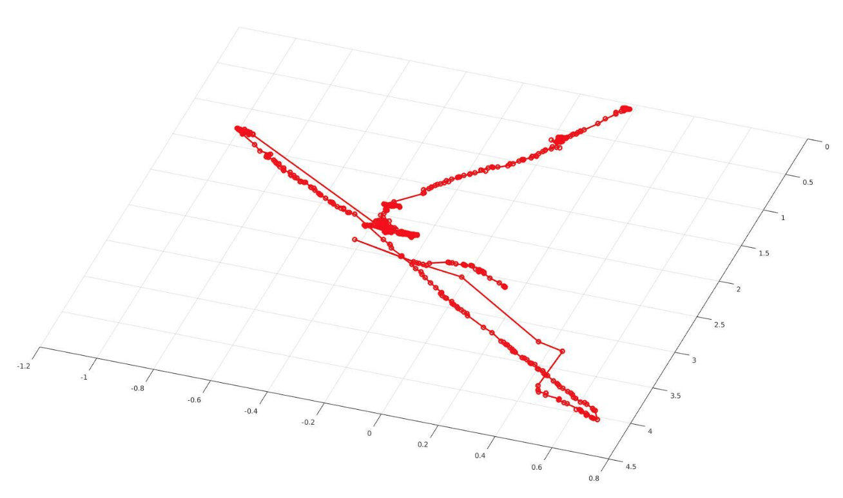
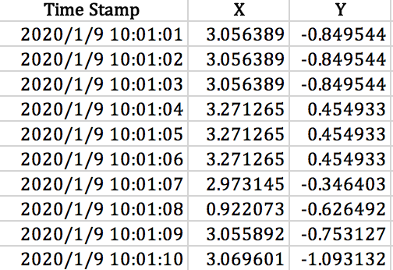
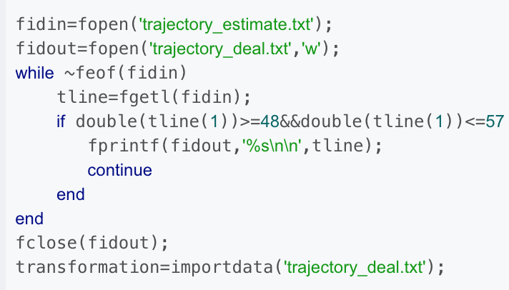
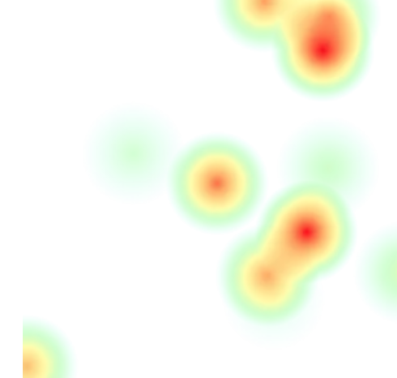
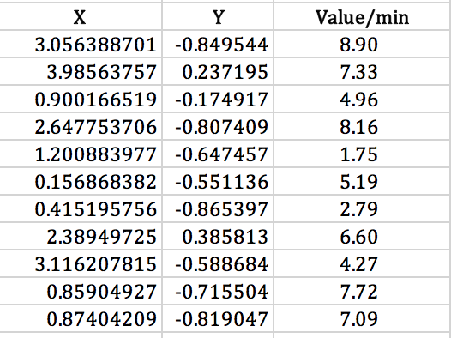
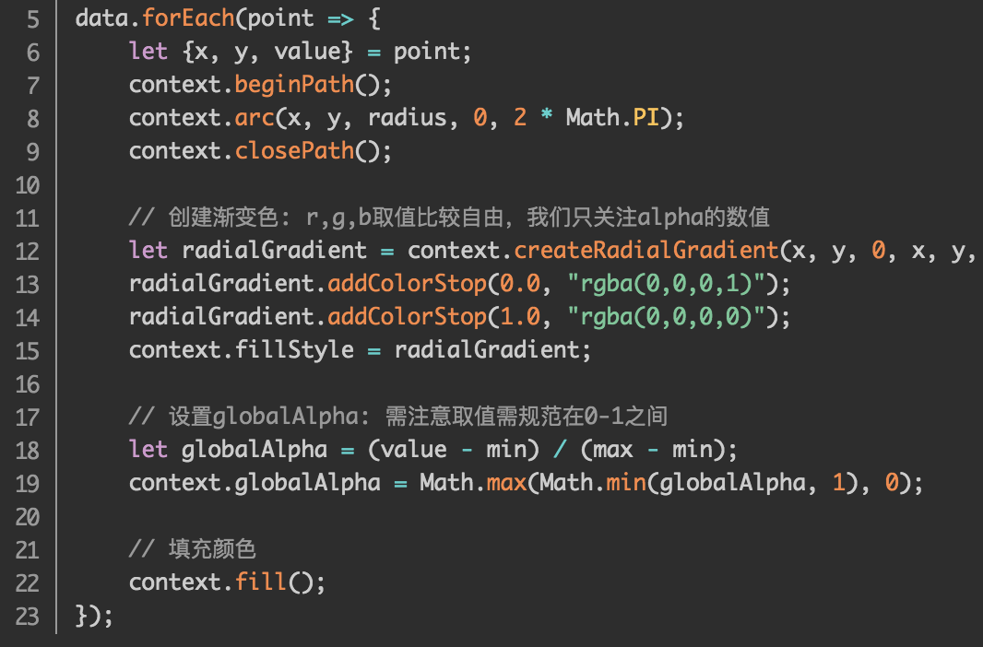
Data Visualization: Single customer shopping track
Single Customer Track Data
Data Processing
Data Visualization
Time Stamp
Location
transformation()
Alignment
Plot ( )
Data Polymerization
Map & Color
Heat Map
Time Stamp
Residence Time
Map each data to a circle
Select a linear dimension to indicate the strength of the data,
radialGradient()
Overlay circles
Color mapping with intensity chromatography

Slide 30
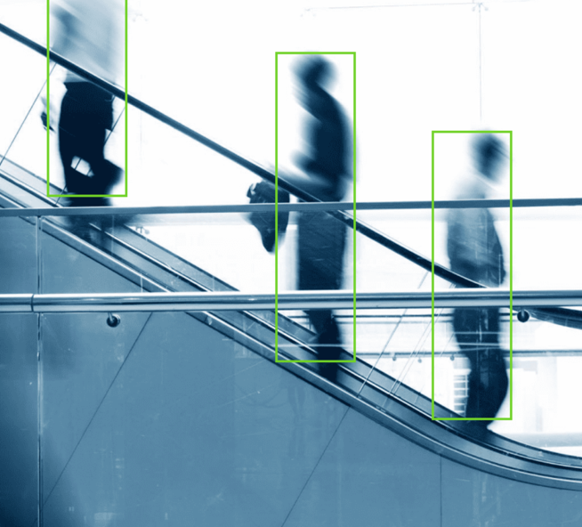
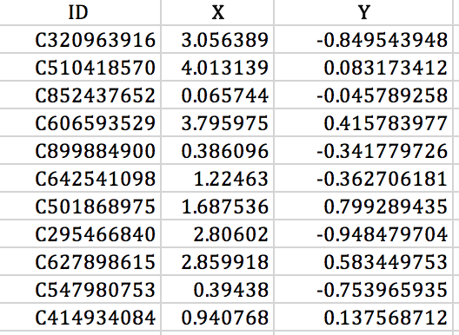
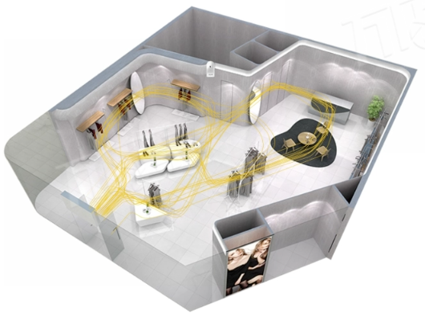
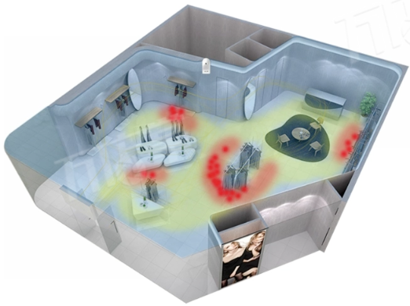
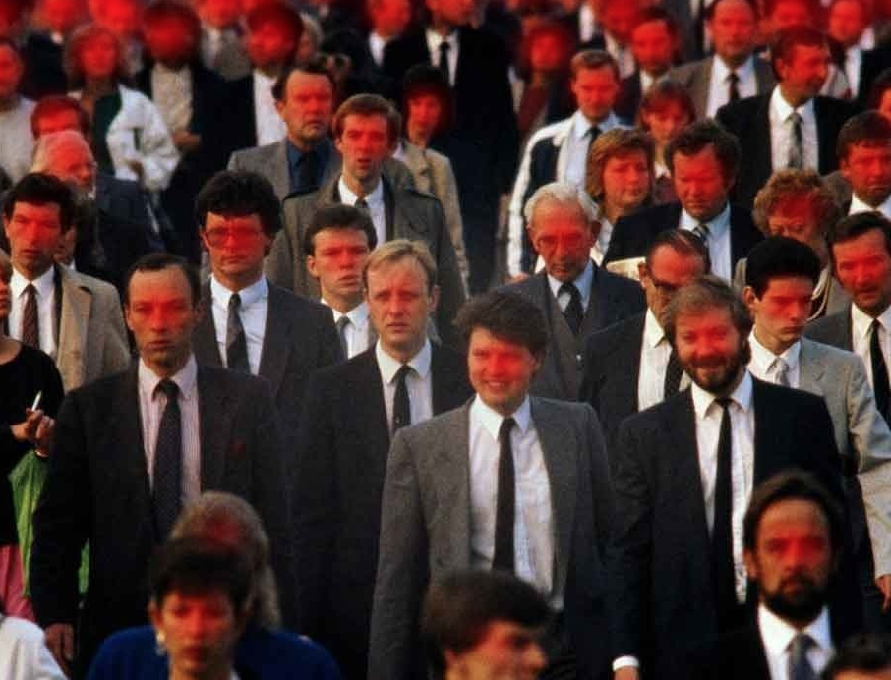
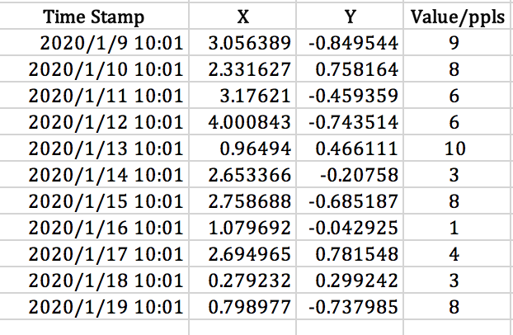
Data Visualization: Multi customer shopping track
Multi Customer Track Data
Statistical Analysis
Statistical Analysis
Hot Spot Area
Retention Rate
Popular Route
Floor diversion
Merchant Relevance
Layout Adjustment
Wandering Depth
Recommendation Strategy
Notes:
Merchant relevance
Layout adjustment
Wandering depth
Put in Recommendation

Slide 31

Platform Demo
Data Analysis Platform Demo
Member
Melody
Recent purchase: ¥ 2020
Last consumption amount: ¥ 2000
Regular items: sandals / skirts / sleeves
Notes:
Merchant relevance
Layout adjustment
Wandering depth
Put in Recommendation

Slide 32
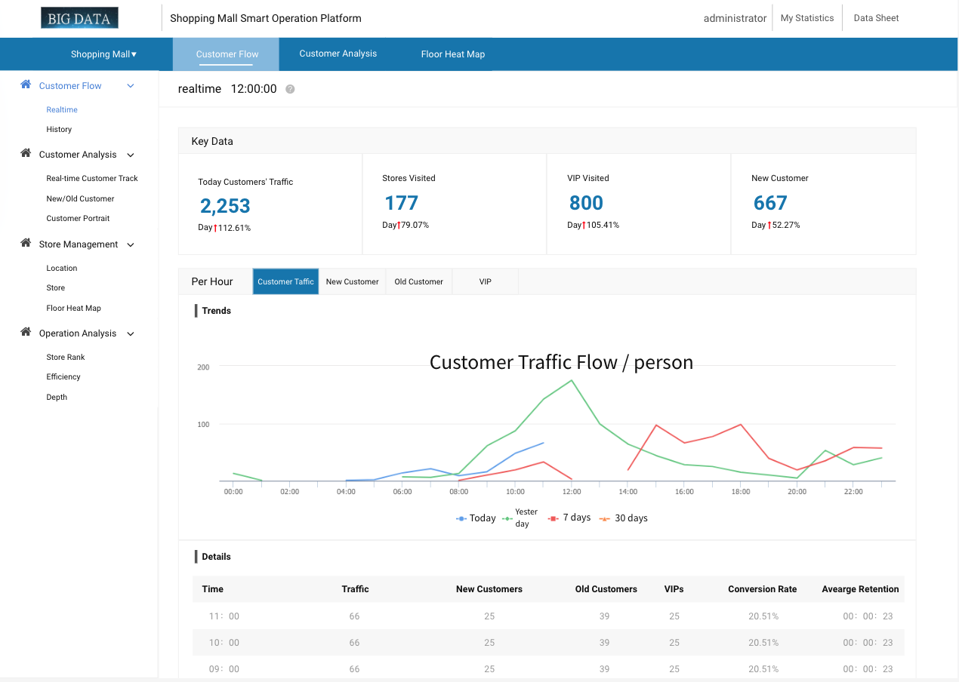
Platform Demo
Shopping
Mall
Platform

Slide 33
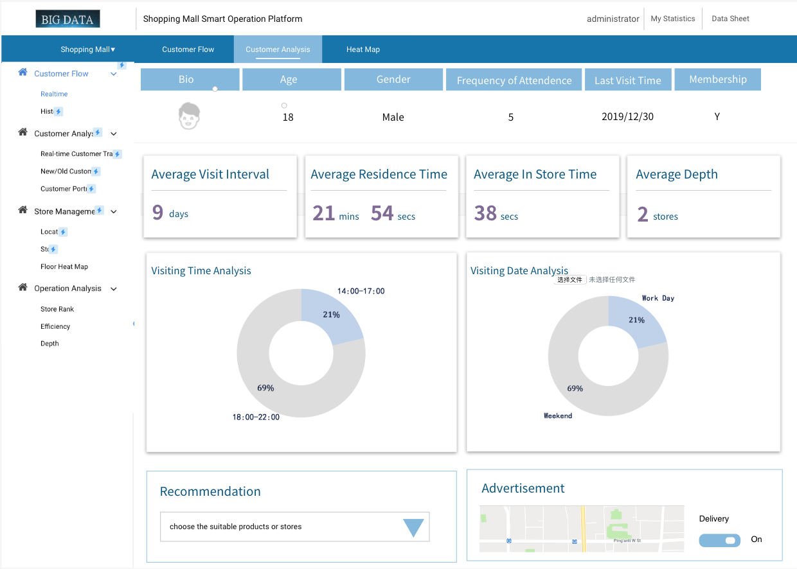
Platform Demo
Shopping
Mall
Platform
Notes:
Merchant relevance
Layout adjustment
Wandering depth
Put in Recommendation

Slide 34

Platform Demo
Shopping
Mall
Platform
Notes:
Merchant relevance
Layout adjustment
Wandering depth
Put in Recommendation

Slide 35
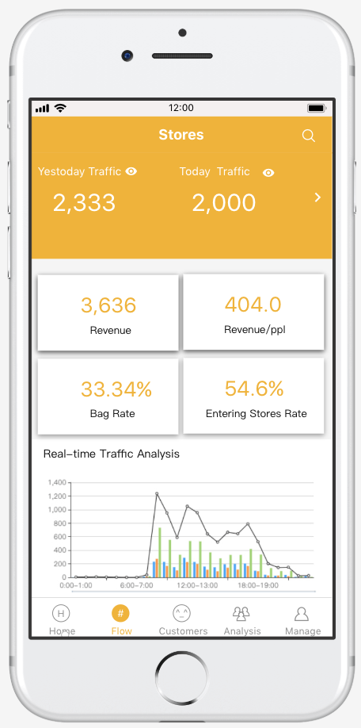
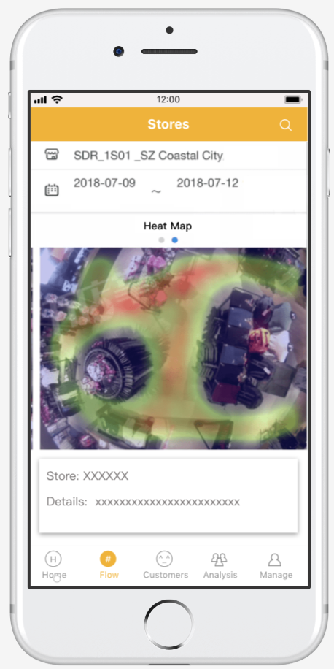
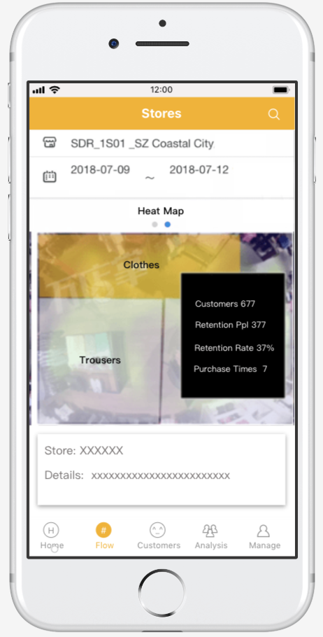
Platform Demo
Stores
Platform
Notes:
Merchant relevance
Layout adjustment
Wandering depth
Put in Recommendation

Slide 36
References
[1]P. Viola, M.J. Jones, Robust real-time face detection, Int. J. Comput. Vis. (IJCV) 57 (2) (2004) 137–154.
[2]S. Yan, S. Shan, X. Chen, W. Gao, Locally assembled binary (LAB) feature with feature-centric cascade for fast and accurate face detection, in: IEEE Conference on Computer Vision and Pattern Recognition (CVPR), 2008, pp. 1–7.
[3] J. Li, T. Wang, Y. Zhang, Face detection using SURF cascade, in: IEEE International Conference on Computer Vision Workshops (ICCVW), 2011, pp. 2183–2190.
[4] M. Schmidt, minFunc: Unconstrained Diﬀerentiable Multivariate Optimization in Matlab, http://www.cs.ubc.ca/~schmidtm/Software/minFunc.html, 2005.
[5] Y.C. Eldar, P. Kuppinger, H. Bolcskei, Block-sparse signals: uncertainty relations and eﬃcient recovery, IEEE Trans. Signal Process. 58 (6) (2010) 3042–3054.
[6] D.G. Lowe, Distinctive image features from scale-invariant keypoints, Int. J. Comput. Vis. 60 (2) (2004) 91–110.
[7] Doll´ar, P., Welinder, P., Perona, P.: Cascaded pose regression. In: IEEE Conference on Computer Vision and Pattern Recognition (CVPR), pp. 1078–1085 (2010)
[8] Cao, X., Wei, Y., Wen, F., Sun, J.: Face alignment by explicit shape regression. In: IEEE Conference on Computer Vision and Pattern Recognition, CVPR, pp. 2887–2894 (2012)
[9] Xiong, X., De la Torre, F.: Supervised descent method and its applications to face alignment. In: IEEE Conference on Computer Vision and Pattern Recognition, CVPR (2013)
[10] Burgos-Artizzu, X.P., Perona, P., Doll´ar, P.: Robust face landmark estimation under occlusion. In: IEEE International Conference on Computer Vision, ICCV (2013)
[11]Krizhevsky A, Sutskever I, Hinton G E. Imagenet classification with deep convolutional neural networks. In: Proceedings of Advances in Neural Information Processing Systems. 2012, 1097–1105
[12]Szegedy C, Liu W, Jia Y, Sermanet P, Reed S, Anguelov D, Erhan D, Vanhoucke V, Rabinovich A. Going deeper with convolutions. arXiv preprint arXiv:1409.4842, 2014
[13]Simonyan K, Zisserman A. Very deep convolutional networks for large-scale image
[14] Krizhevsky A, Sutskever I, Hinton G E. Imagenet classiﬁcation with deep convolutional neural networks. In: Proceedings of Advances in Neural Information Processing Systems. 2012, 1097–1105
[15] Simonyan K, Zisserman A. Very deep convolutional networks for large-scale image recognition. arXiv preprint arXiv:1409.1556, 2014

Slide 37
THANK YOU!
Q&A

